Slide 1


PRESENTATION

Slide 2
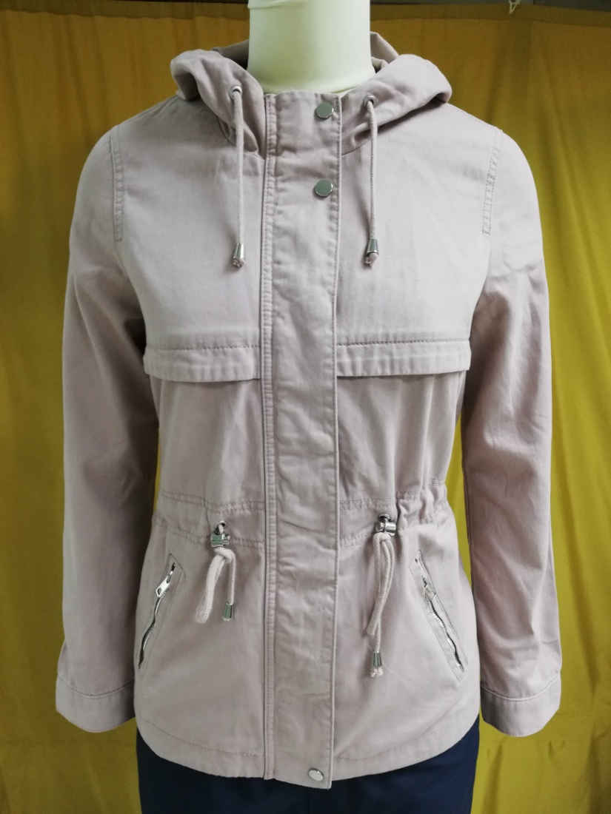
BUYER-H&M
STYLE: Falcon Parka
Shell: 100% Cotton Twill
Fiber filling :N/A
Item : Women's JKT
wash: ENZ
FOB $ : 14.00

Slide 3

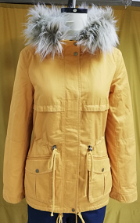
BUYER-H&M
STYLE: Carla Parka
Shell: 100% Cotton Twill
Item : Women's JKT
FOB $ : 16.50
Wash : ENZ

Slide 4
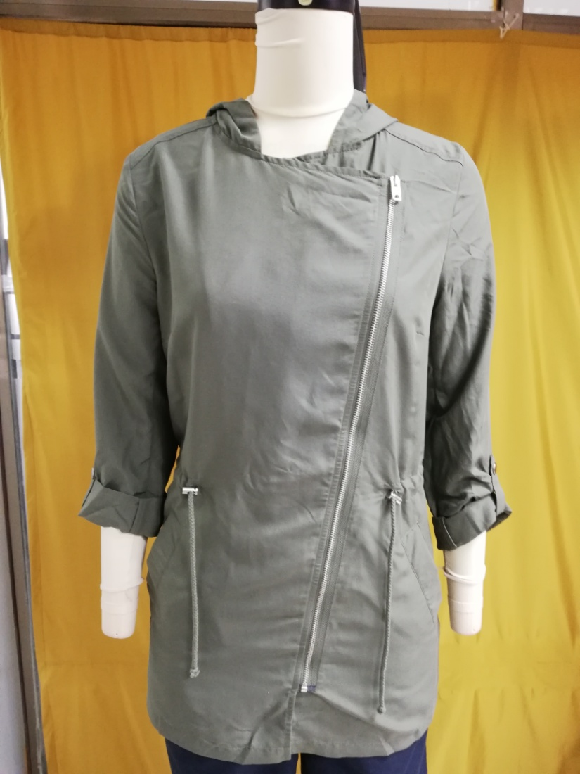
BUYER-H&M
STYLE: Peach Parka
Shell: viscose 72% 28% polyester.
Fiberfill: N/A
Item : Women's JKT
Non wash
FOB $ : 10.50

Slide 5
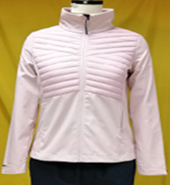
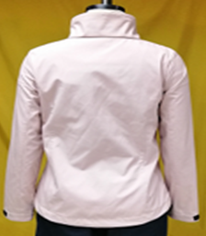
Buyer:OTCF
Style: D4Z19-SFD302 (Women Soft Shell Jacket)
Shell: Body-1: 100 % Polyester Woven Fabric Bonded With 100% Polyester Interlock, Membrane: TPU Lamination Wp 8000/ MVP 6000, DWR Finishing , Body-2:100% Polyamide Full Dull 20D*20D 380T (Matt & DWR Finishing)
Tricot: 100% Polyester Tricot
Padding: 100% Polyester Fake Down
Fob: $ / Pcs.16.70

Slide 6
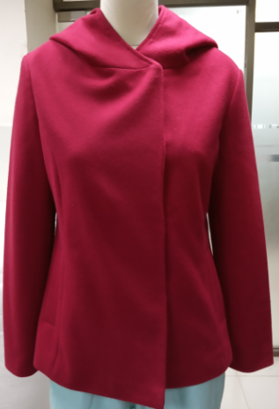
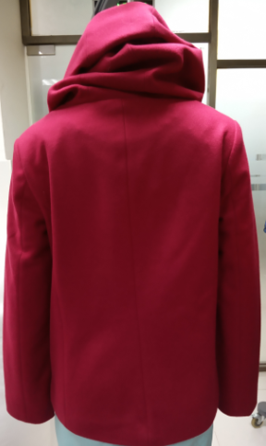
Buyer: C&A
STYLE: Wenka Jacket
Shell: viscose 78% polyester, 11%Rayon,11%Acrle
Lining:100%Polyester 210T
Fiberfill: N/A
Item : Women's JKT
Non wash
FOB $ :15.60

Slide 7

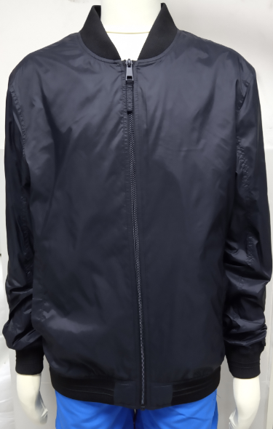
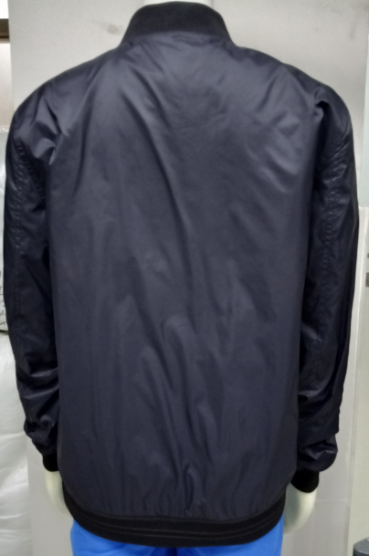
L
BUYER:C&A
FOB:7.60
STYLE:1/2012/01004/001
SHELL FABRIC:100 % NYLON
LINING FABRIC:100 % POLYESTER 210T
TAFFETA
FOB:6.9500

Slide 8
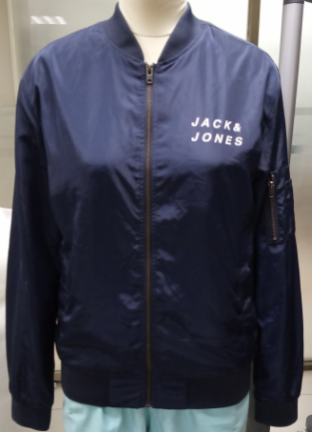
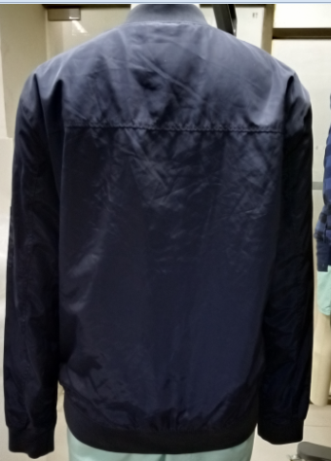
Buyer:Jack & Jones
STYLE: JCOSNIPE
Shell: 100% Cotton Twill
Item : Women's JKT
Enzyme wash
FOB $ : 11.70

Slide 9
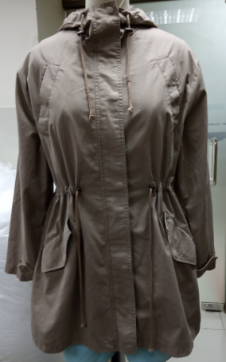
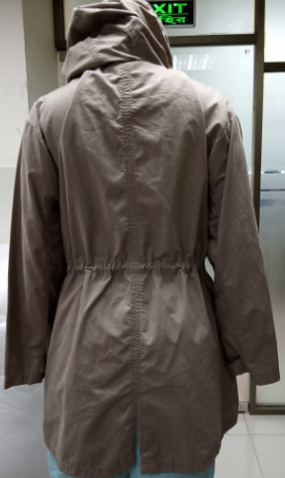
Buyer: KAPPAHL
STYLE:PANDORA JKT
Shell: 100% Cotton
Lining:100% Cotton TC
Item : Women's JKT
Enzyme wash
FOB $ : 13.80

Slide 10
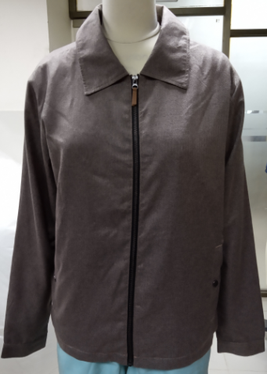
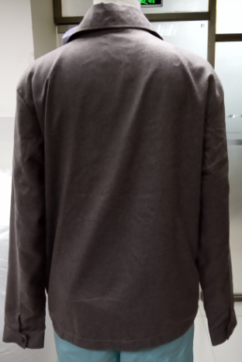
Buyer: C&A
STYLE:19/2/2023/0100415
Shell: 100%Polyester
Lining:100%Polyester 210T AOP
Item : Women's JKT
Enzyme wash
FOB $ :14.41

Slide 11
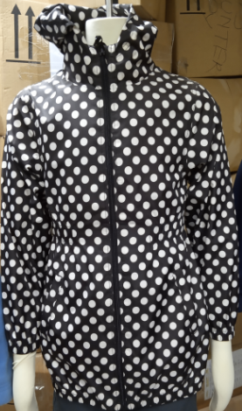
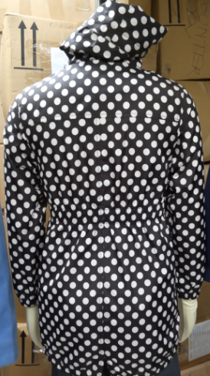
Buyer: KMART
STYLE:08W18AJ001
Shell: 100%Polyester Pongee With PU Milky coating.
Item : Women's JKT
Non wash
FOB $ : 6.50

Slide 12
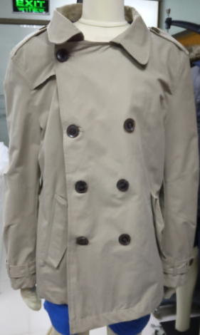
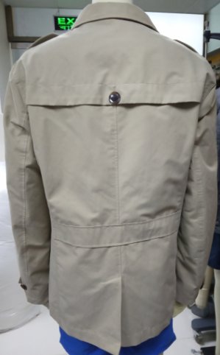
Buyer: TEMA
STYLE:TRENS COAT
Shell: 70% Cotton,30%P[olyester
Item : Women's JKT
WASH
FOB $ :14.00

Slide 13
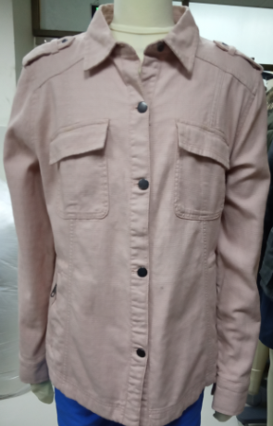
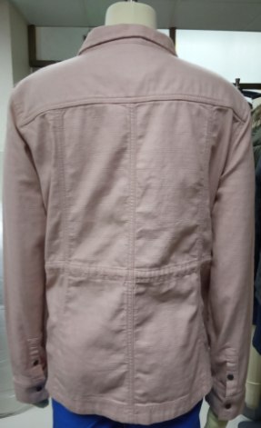
Buyer: NEXT
STYLE:SHIRT JACKET
Shell: 100% Cotton Dobby Strike
Item : Women's JKT
WASH
FOB $ : 16.11

Slide 14
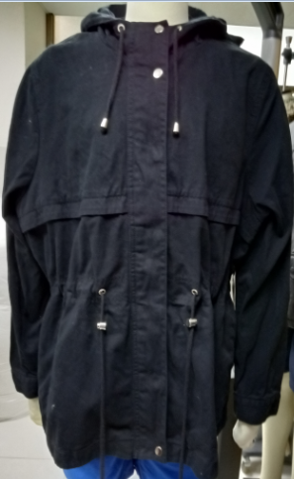
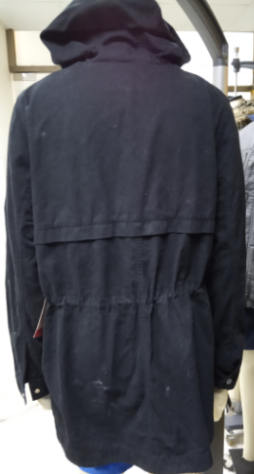
Buyer:TEMA
STYLE:Shail
Shell: 100% Cotton Twill
Item : Women's JKT
WASH
FOB $ :14.00

Slide 15
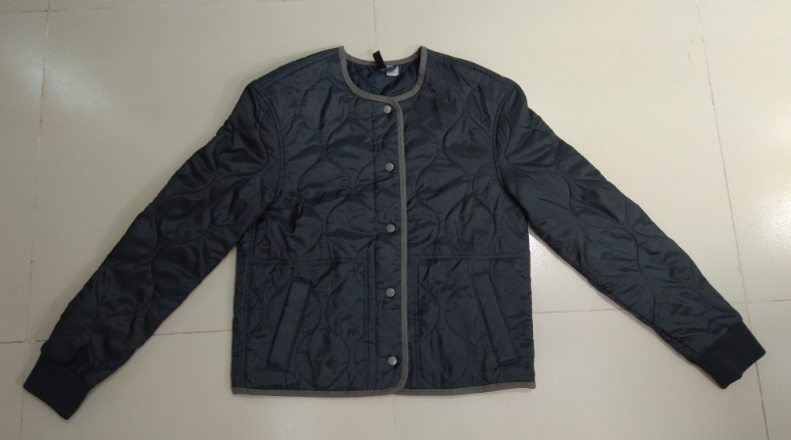
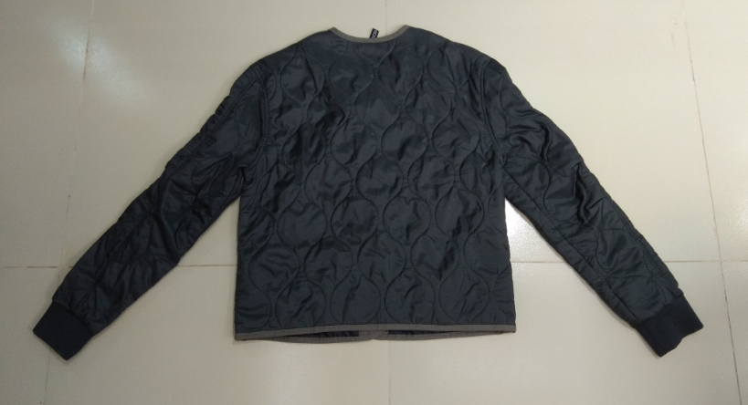
STYLE : CROCODILE JKT
Fabric composition: 100%Polyester Rib Stop
FOB : $ 9.88

Slide 16
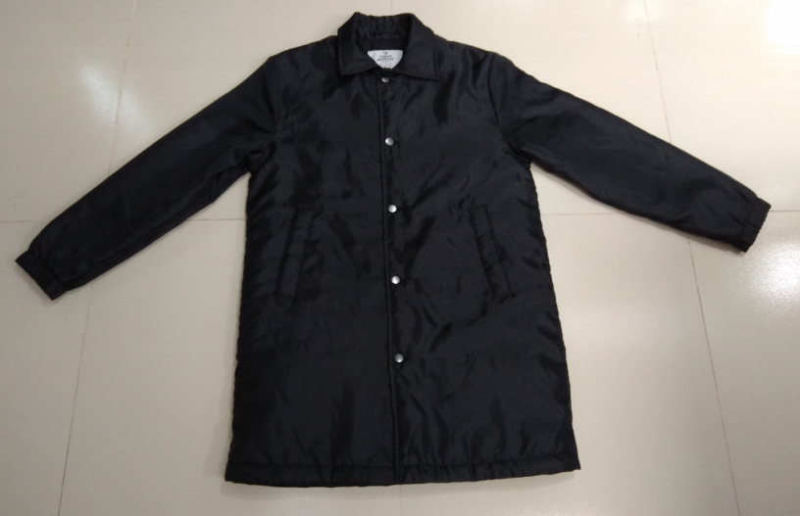
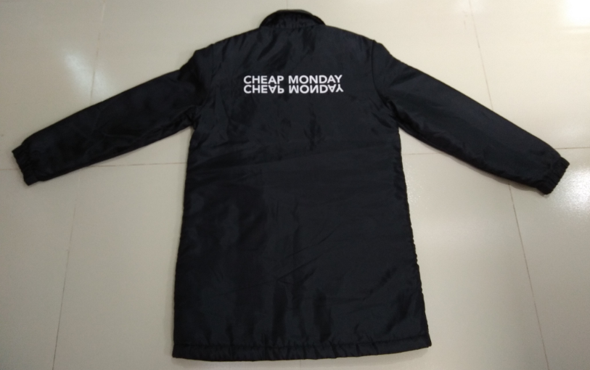
STYLE : CORE COAT
FABRIC :
COMP : 100%P,oly
FAB PRICE : $2.60 /YDS
FOB : $ 17.95

Slide 17
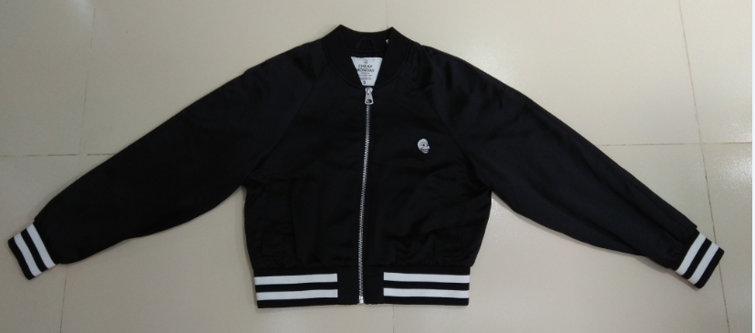
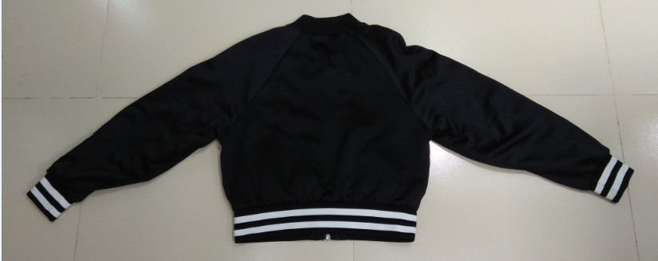
STYLE : HEART JACKET
FABRIC :
COMP : 100%Poly,
FAB PRICE : 2.96$/YDS
FOB : $ 14.25
.

Slide 18
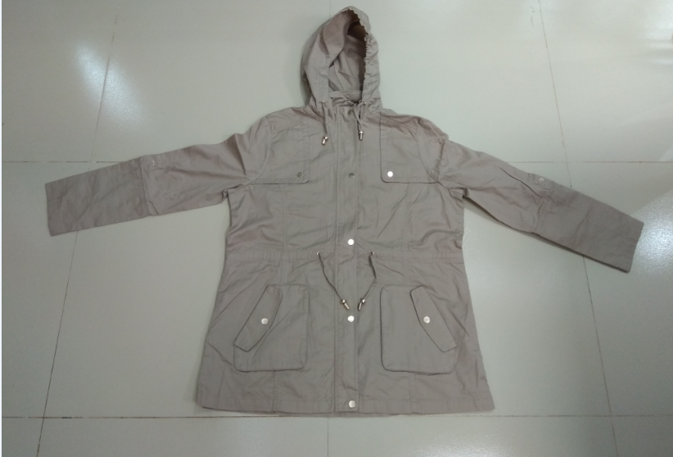
STYLE : SHAHIL JACKET
FABRIC :
COMP 100%Cotton,
FAB PRICE : 1.45$/YDS
FOB : $ 10.20

Slide 19
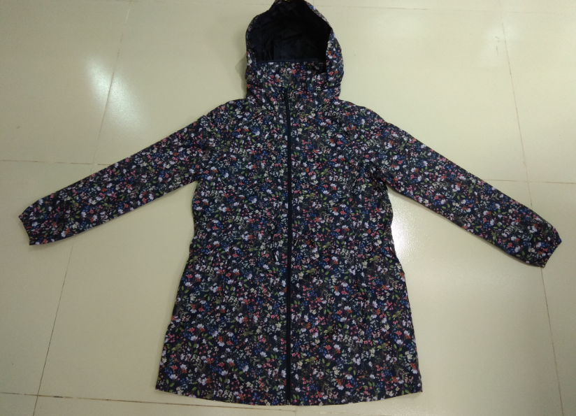
STYLE : SEAN JACKET
FABRIC :
COMP :
100% Polyester
FAB PRICE : 2.48$/YDS
FOB : $ 8.18

Slide 20
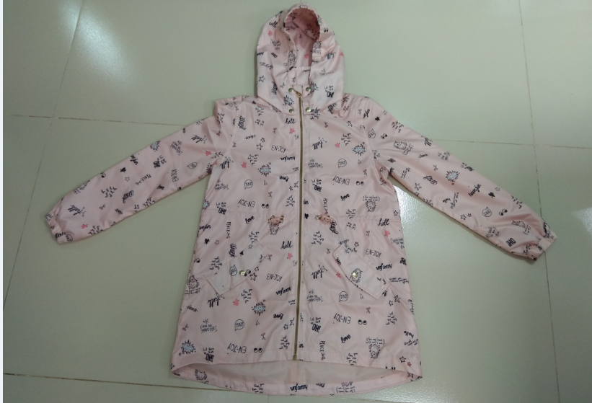
STYLE : KELLY WIND BREKER
FABRIC :
COMP :
100% Polyester,
FAB PRICE : 1.80$/YDS
FOB : $ 7.50

Slide 21
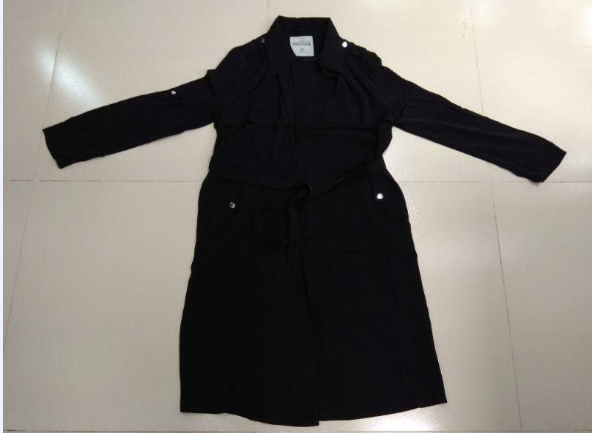
STYLE: BENCER
FABRIC :
COMP : 100%Polyester
FOB : $ 9.40

Slide 22
Thank You

